Slide 1
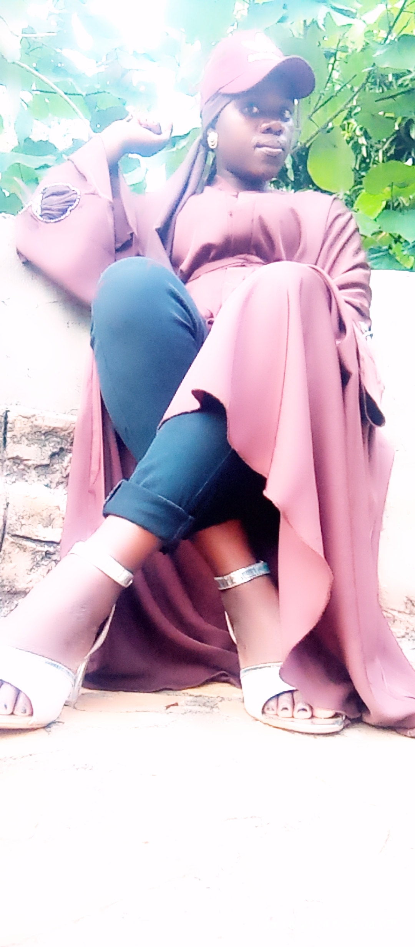
ALL ABOUT ME
Nawamwena Nazifa Cohort4

Slide 2
My hobbies
Swimming; To me swimming is best Hobbie because when ever am stressed, it refresh my mind and be able to find a way out.
Touring; I love travelling to new areas with an aim of discovering new adventures.
Cooking. I believe in the power of food to connect people, community and society
Watching movies. When am in my leisure time I love watching movies as it helps me learn a lot about things that happen in real life
Listening to music

Slide 3
Brief information about me
Am Nawamwena Nazifa, a janitor passionate computer programmer.
I come from magamaga in Mayuge district Busoga region.
My favorite color and food is green and flied fish consecutively.

Slide 4
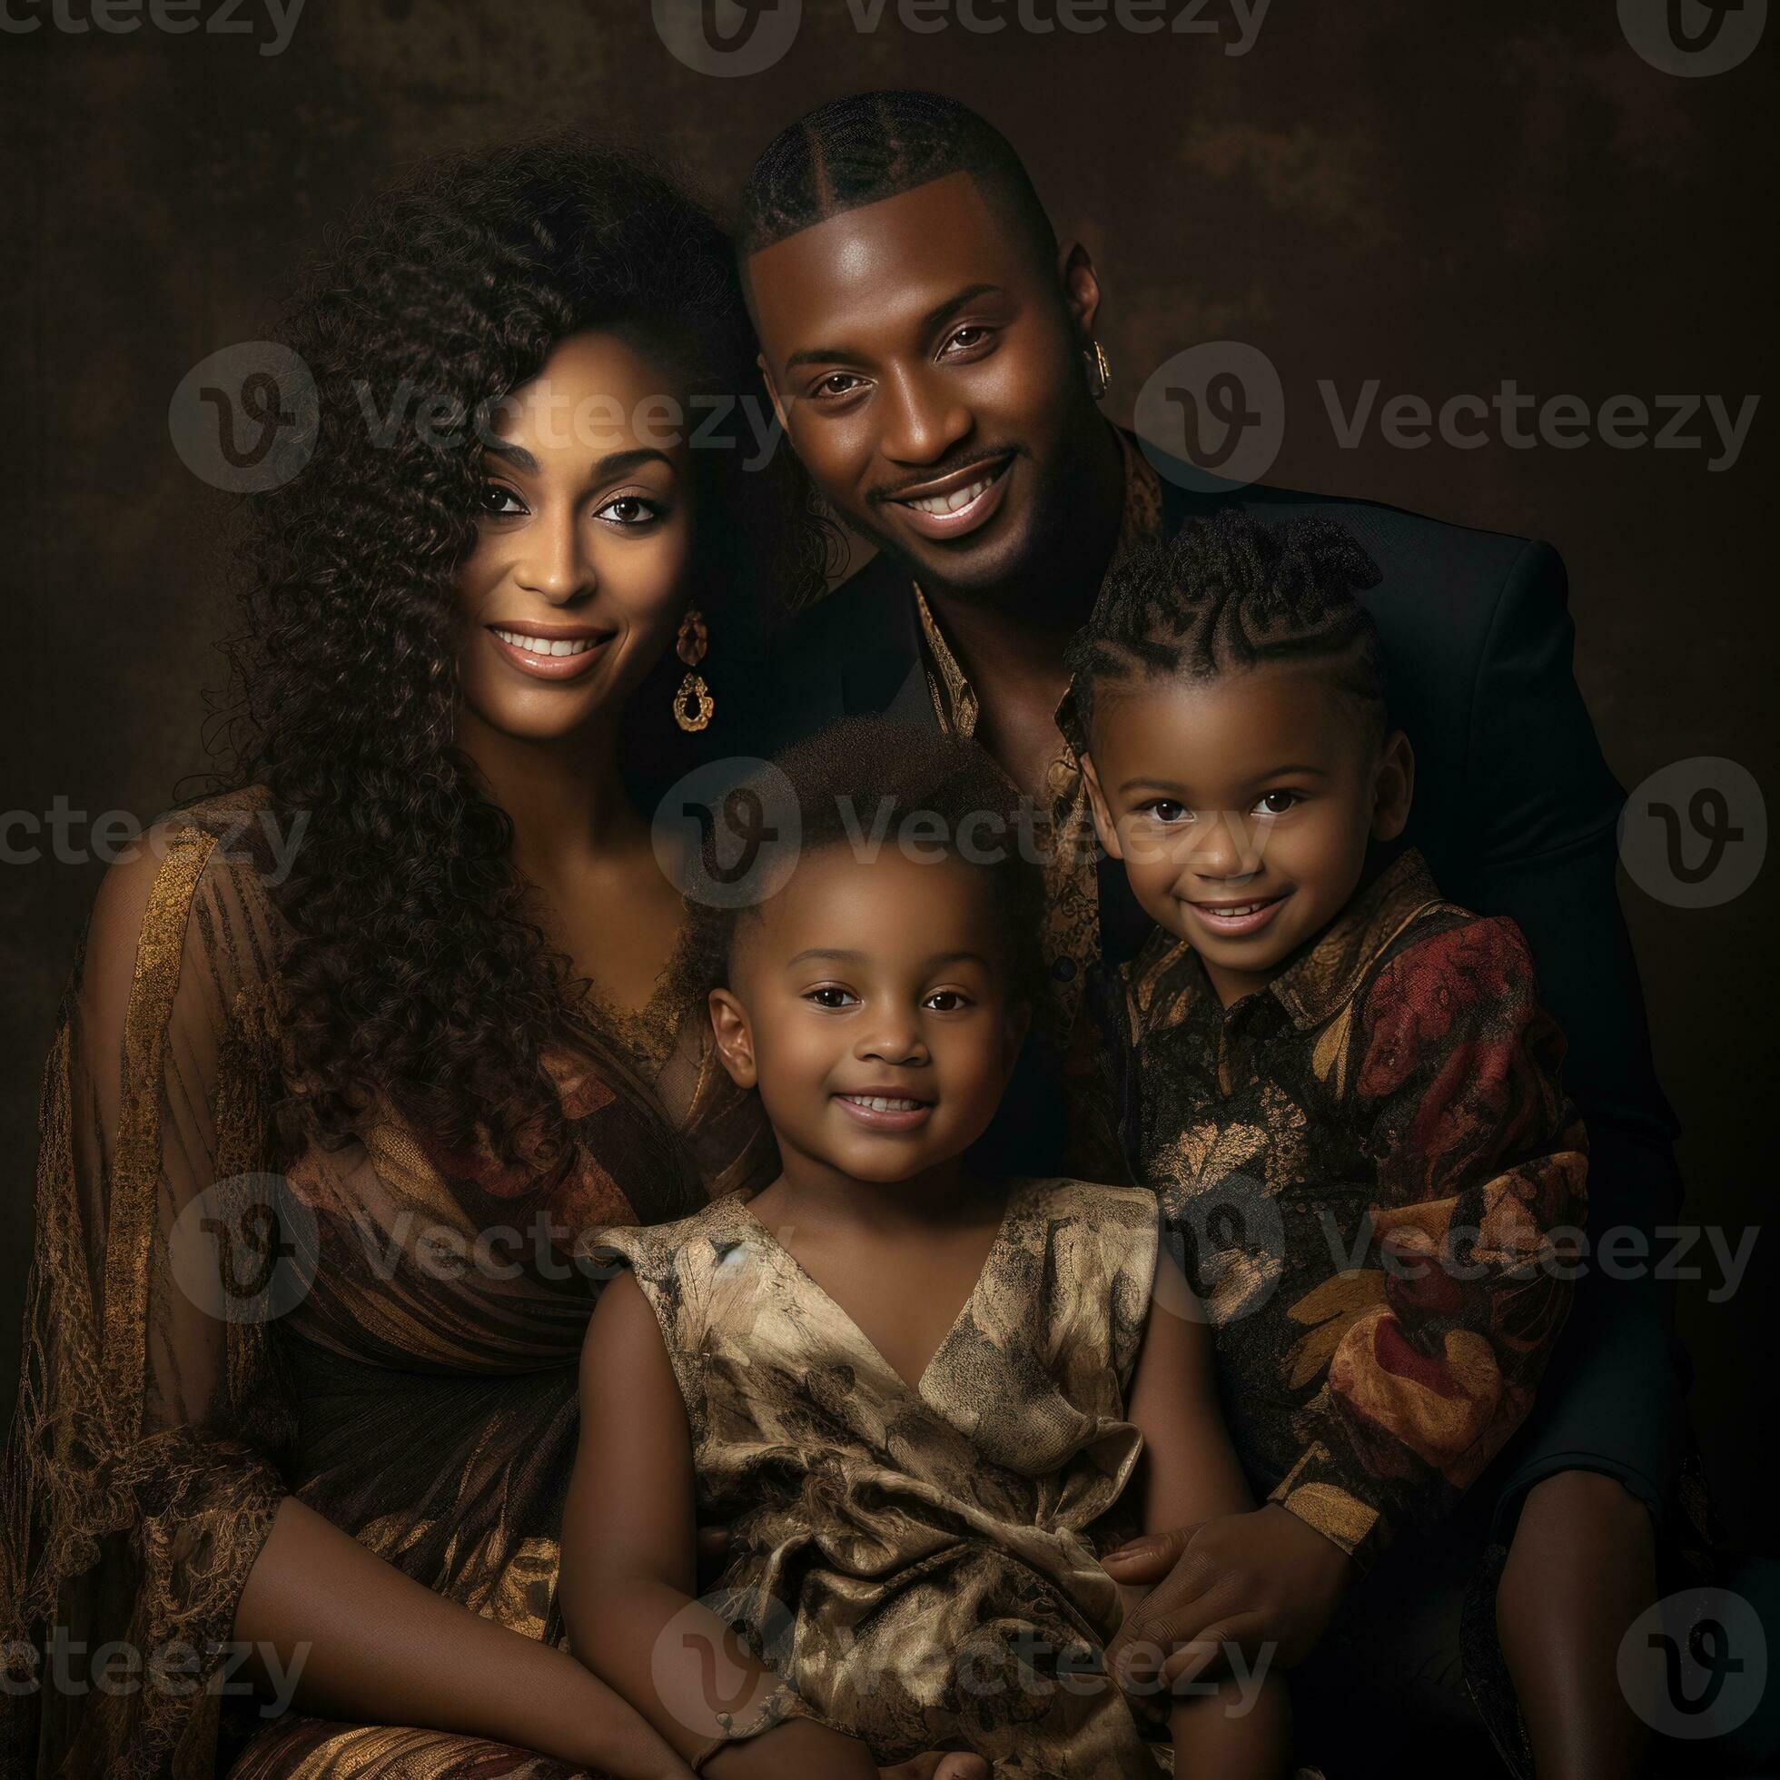
Family members
Father: Abdul Latiphu
Mother: Nantele Nulu
Brother: Abdul Shakul
Me: Nawamwena Nazifa

Slide 5

Favorites
Movies | Books | music
Gods must be crazy | Betray in the city | Akaliro
Beyonce | The carrier of hope | Like I do
Destined to love you | Alien woman | byadala

Slide 6
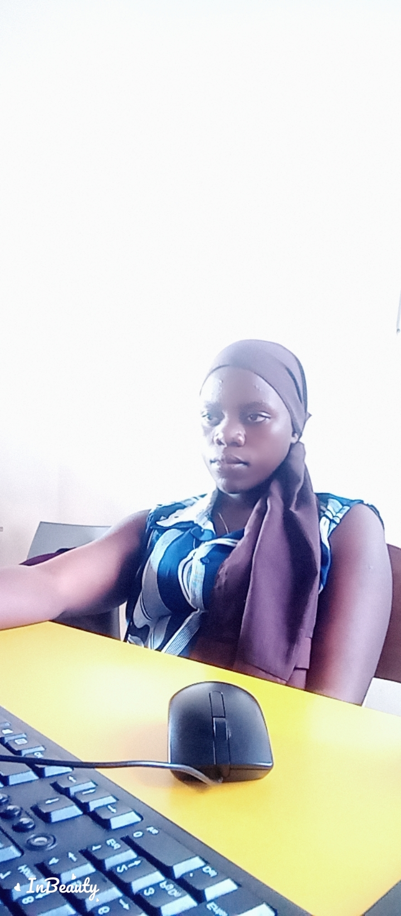
Future goals
Dreams: An independent lady
Career goals : website developer, computer programmer, graphics designer
Role model to people

Slide 7

Thank you
I remain Nawamwena Nazifa

